Slide 1
INFSCI 2500 Lecture 1 Introduction to Java

Slide 2
Syllabus

Slide 3
Java is class based
Class consists of variables and methods
Hello has one method (main) and no variables
Case sensitive
public class hello{
public static void main(String[] args){
System.out.println(“hello world”);
} //end main method
} //end class hello

Slide 4
Java is compiled
Machine Code != byte code
javac is the JDK compiler
“javac hello.java” on the command line creates hello.class
“java hello” on the command line runs the program
Source file name and class name are the same
.java is the file extension

Slide 5
Java Virtual Machine
JVM converts bytecode to machine code and executes it
Write Once Run Anywhere
Whitespace is meaningless except in literals and names
int aNumber != int a Number

Slide 6
Arguments
Public static void main (String[] args)
Hard coded
Passed in as parameters on command line
Passed in from keyboard while program runs
Some other source (DB, file, Internet)

Slide 7
Primitives
Integers:
byte – 8 bit signed integer (-128 to 127)
short – 16 bit signed integer (-32768 to 32767)
int – 32 bit signed integer (-2³¹ to 2³¹-1)
long – 64 bit signed integer (-2⁶³ to 2⁶³-1)
Reals:
double (64 bit floating point)
float (32 bit floating point)
char – 2 bytes (unicode)
Boolean – 1 byte (true/false)

Slide 8
Creating Primitives
TYPE VARIABLE_NAME;
Examples:
int x;
double balance=5.34;
long time=12;
char b = ‘b’; char b=98; char b=0x62;
boolean flag = true;
Default values 0 or false

Slide 9
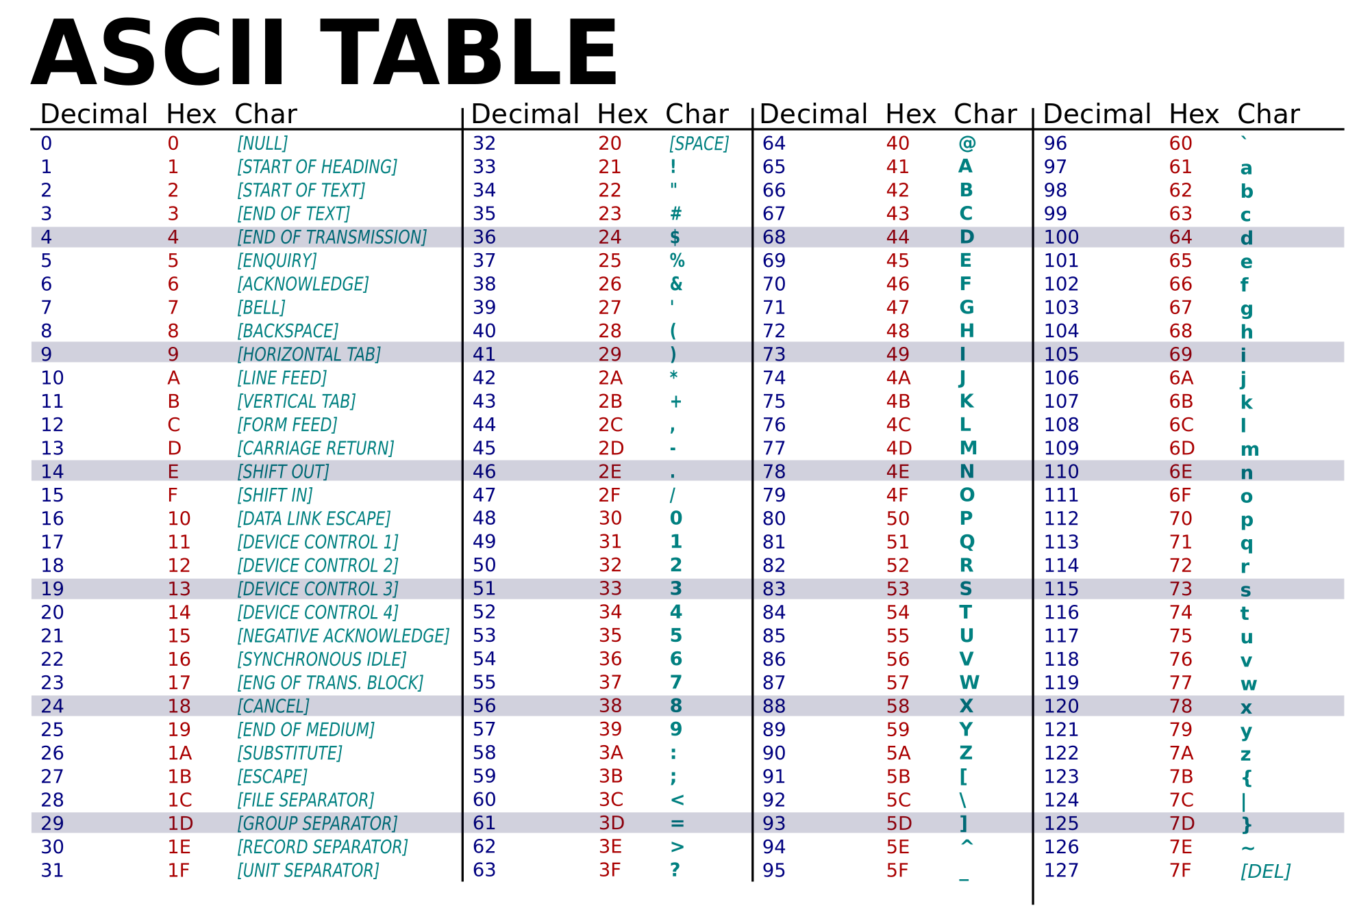
American Standard Code for Information Interchange

Slide 10
Naming Variables
Start with letter, underscore, $
Followed by letters, numbers, underscore or $
No reserved words
camelCase
int score2
String myString
boolean myFlagWithWords3

Slide 11
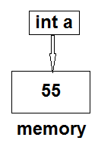
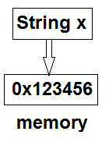
Pointers
Primitives
Objects

Slide 12
String Class
Strings are objects
Object names point to an address, not the actual value.
String myString; //null
String myString=“Hello world”;
String myString=new String(“hello world”);

Slide 13
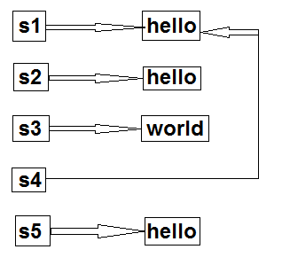
Comparing Strings
This goes for all objects
== only compares object references
equals() compares object content
String s1=new String(“hello”);
String s2=new String(“hello”);
String s3=new String(“world”);
String s4=s1;
String s5=“hello”;
s1.equals(s2) //true
s1.equals(s3) //false
s1==s2 //false
s1==s4 //true
s1==s5 //false

Slide 14
Special Characters
\ is the escape character
\' | Single quotation mark
\" | Double quotation mark
\\ | Backslash
\t | Tab
\b | Backspace
\r | Carriage return
\f | Formfeed
\n | Newline

Slide 15
Logical and Math Operators
&& //and
|| //or
! //not
= //assignment
== //equal
!= //not equal
++,-- //increment, decrement
+-*/% //add, subtract, multiply, divide, mod
<,<=,>,>= //inequalities
Math.pow(x,y) //x^{y}
Math.sqrt(x) //x^{1/2}
Math.abs(x) //|x|

Slide 16
Concatenation
Combine strings with +
String s=“University”+” of ”+”Pittsburgh”;
System.out.println(s); //University of Pittsburgh
Beware!
System.out.println(1+2+”hello world”+3+4);
//3hello world34

Slide 17
Conditionals
If (condition)
{
//executed if condition is true
}
else if(condition) //optional
{
//executed if condition is true
}
else //optional
{
//executed if no conditions are true
}

Slide 18
Conditionals Example
if(count>10)
{
count=10;
}
else if(count<0)
{
System.out.println(“count is negative”);
}
else
{
System.out.println(“Count is between 0 and 10”);
}

Slide 19
Loops
while(condition)
{
//executes while condition is true
}
for(initialization;condition;update)
{
//executes while condition is true
}

Slide 20
Loops Examples
while(x>y)
{
System.out.println(y);
y++;
}
for(int i=0;i<10;i++)
{
System.out.println(i);
}

Slide 21
Scanner
Take input from the keyboard
import java.util.Scanner;
public class test{
public static void main (String[] args){
Scanner s = new Scanner(System.in);
System.out.println(“Input a number”);
int x=s.nextInt();
System.out.println(“Input a string”);
String myString=s.nextLine();
}
}

Slide 22
Build a Class
Salary.java

Slide 23
HW1

